Slide 1
EXPO-2017 as a way of improvement business tourism in Kazakhstan

Slide 2
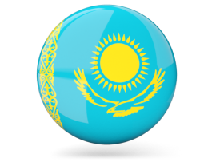
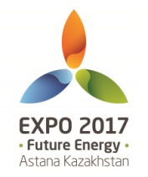
1.Tourism in Kazakhstan
2. Astana – city of the future
3. EXPO-2017

Slide 3
What do you know about
Kazakhstan?
Astana?
EXPO-2017?

Slide 4
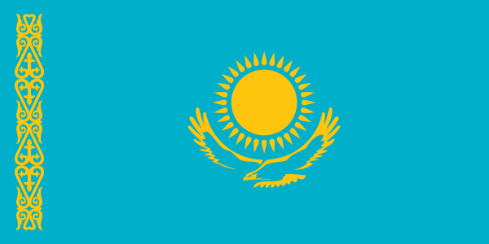
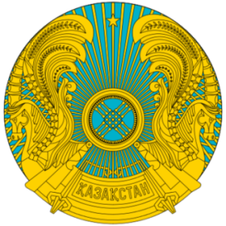
Basic Facts
National Flag
National Emblem
Area: 2,724,000 km² (1,051,742 sq.miles), 9th largest
Population: 17,9 million people (2017)
Official language: Kazakh, Russian
Political system: Presidential republic
Head of State: President
Currency: Tenge (KZT)
Capital: Astana
Administrative division: 14 regions + 2 cities ​of republican significance
Out of 105 elements of Mendeleev’s Table, 99 elements have been discovered in subsoil of Kazakhstan, 70 elements have been explored and over 60 elements have been involved in production.

Slide 5
DOING BUSINESS 2017
Kazakhstan ranked 35th
Source: World Bank, Doing Business 2017

Slide 6
Economy
Kazakhstan
53rd / 138
GLOBAL COMPETITIVENESS INDEX RANKINGS
Rank | Country | Score
1 | Switzerland | 5.8
2 | Singapore | 5.7
3 | USA | 5.7
4 | Netherlands | 5.6
5 | Germany | 5.6
6 | Sweden | 5.5
43 | Russian Federation | 4.5
53 | Kazakhstan | 4.4
69 | Hungary | 4.2
85 | Ukraine | 4.0
138 | Yemen | 2.7
Source: World Economic Forum, Global Competitiveness Report 2016-2017

Slide 7
Economy
Kazakhstan
85th / 141
The Travel & Tourism Competitiveness Index 2015 Ranking
Rank | Country/Economy | Value
1 | Spain | 5.31
2 | France | 5.24
3 | Germany | 5.22
4 | United States | 5.12
5 | United Kingdom | 5.12
41 | Hungary | 4.14
44 | Turkey | 4.08
45 | Russian Federation | 4.08
85 | Kazakhstan | 3.48
119 | Tajikistan | 3.03
141 | Chad | 2.43

Slide 8
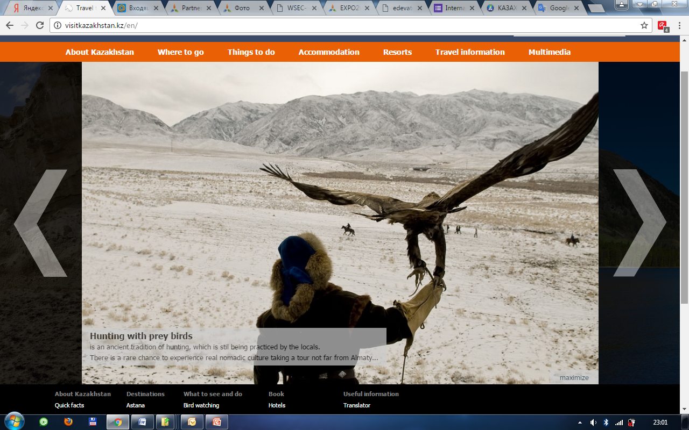

Slide 9
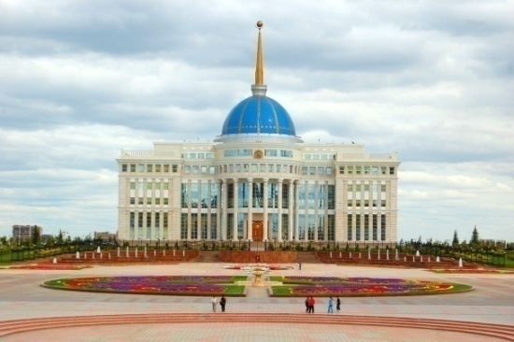
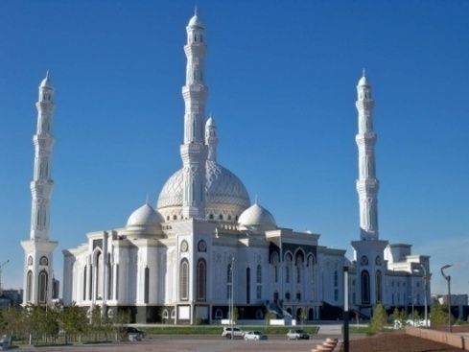
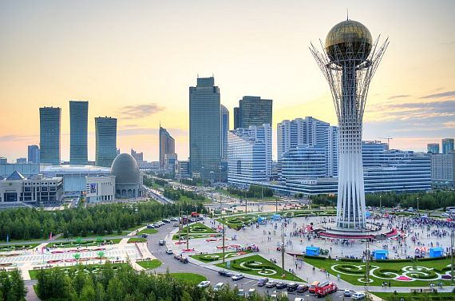
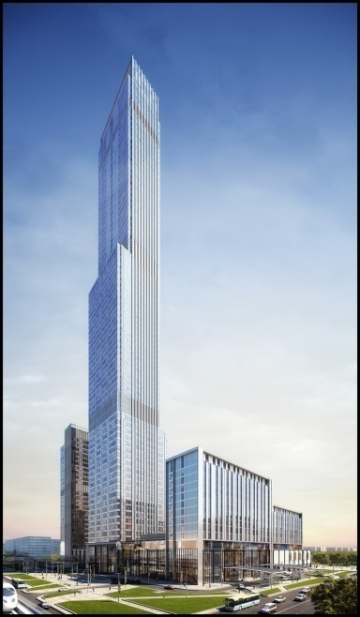
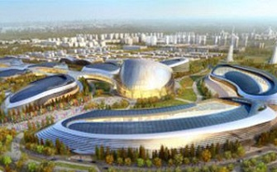
Tourism
Astana has gained its status as the main city of the country on December 10, 1997.
It is a large political, administrative, business and cultural centre
with population of over 800 thousand people.
In July, 1999 Astana was declared a “World City” by UNESCO.
Astana will host an International Exposition
EXPO-2017 “Future Energy”.
The exhibition complex "Astana EXPO-2017" will be self-sufficient urban area with a territory of 174 hectares (430 acres), which will bring together the scientific, technological and cultural facilities, surrounded by open space, residential complexes, shopping and business centers.
The tallest skyscraper in Central Asia “Abu Dhabi Plaza” is planned to be completed in 2017.

Slide 10
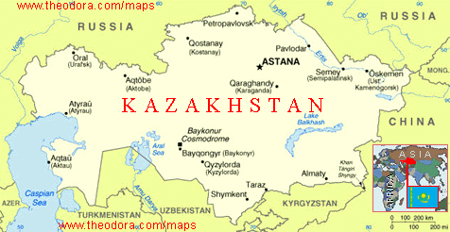

Slide 11
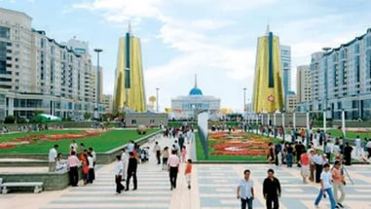
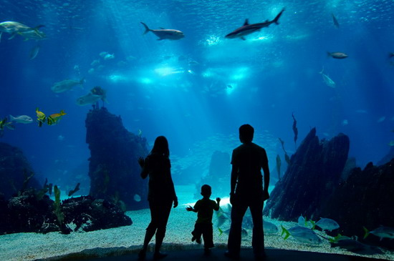
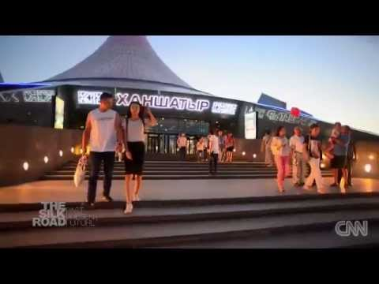

Slide 12
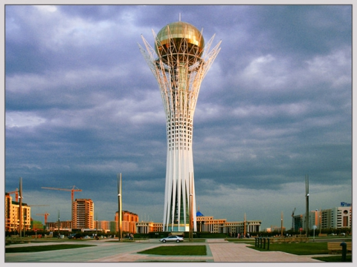
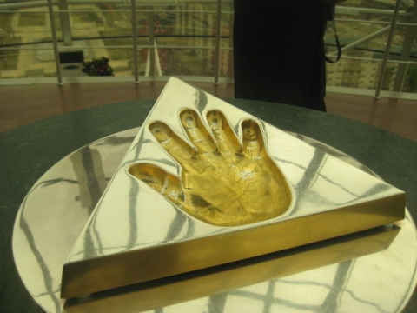
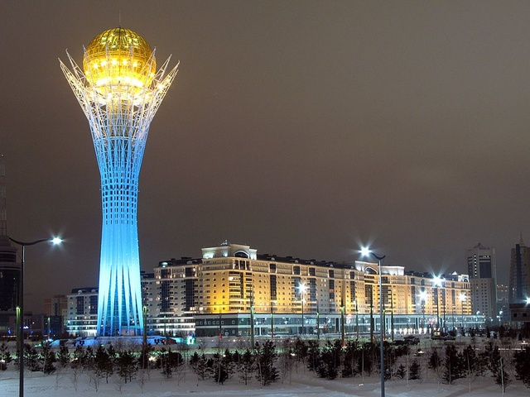
Visitors to Astana love the modern buildings in the city.
Bayterek
Astana’s most famous landmark, is a tower. It’s 105 meters tall and looks like a very big tree. It has a glass ‘egg’ on top of it. Tourists can go up to the egg and get a fantastic view the ‘youngest capital in the world’.

Slide 13
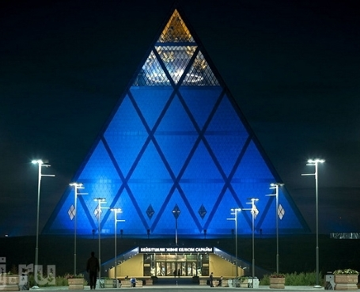
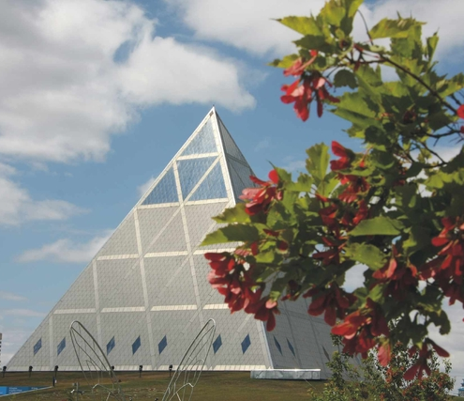
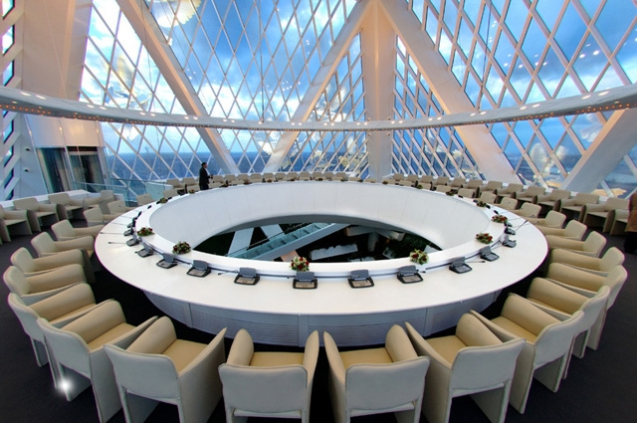
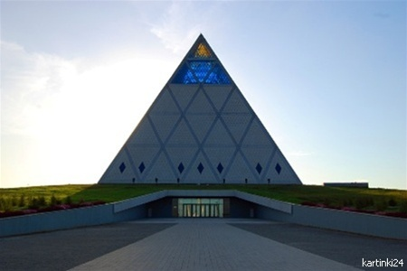
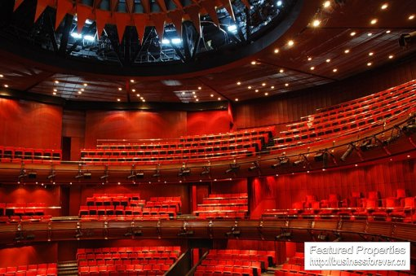
The Palace of Peace and Reconciliation includes a religious center, an opera house with 1.500 seats and a library. It is a perfect pyramid. 62 metres high with a 62 x 62 metres square base.

Slide 14
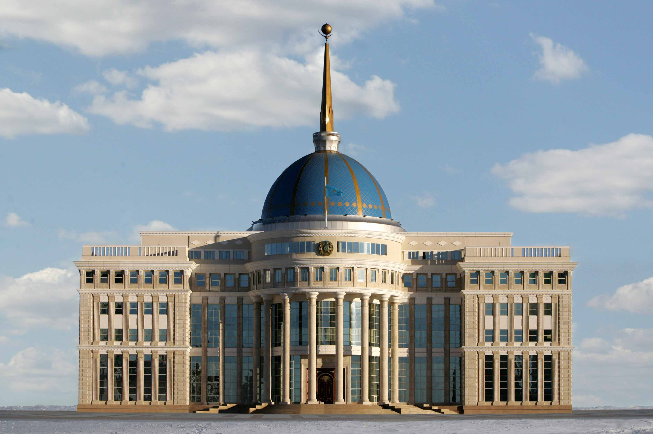
Aq-Orda is the residence of the President of the Republic of Kazakhstan. It is located on the River Ishim’s left bank , three hundred meters from the Bayterek monument.

Slide 15
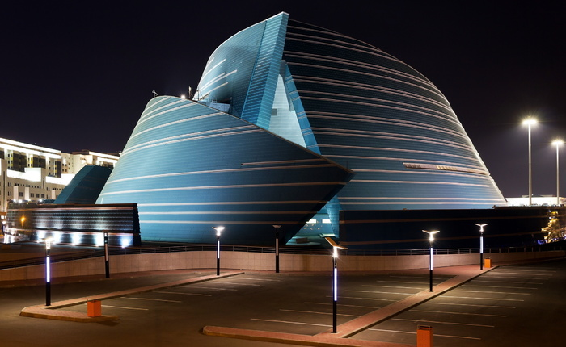
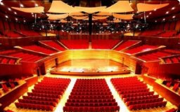
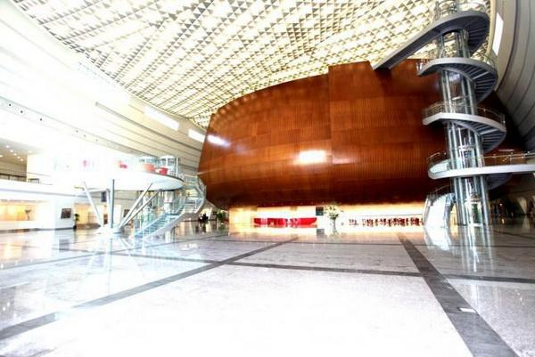
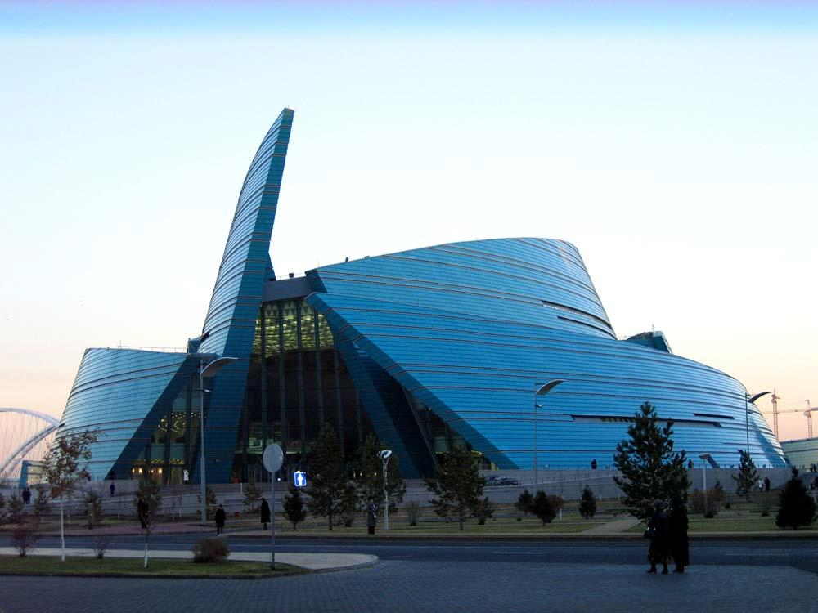
The Central Concert Hall
looks like a flower. Inside the ‘flower’ you can find a very large concert hall (3.500.000 seats), other music halls, a cinema and restaurants.

Slide 16
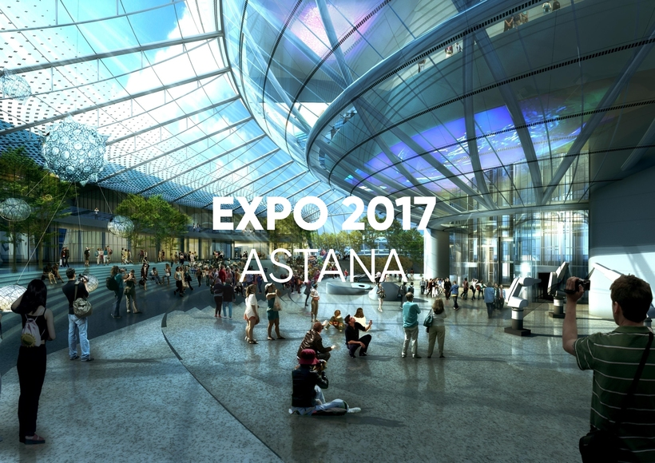

Slide 17
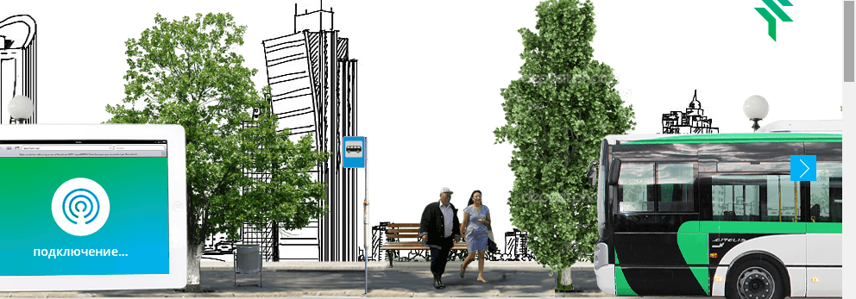
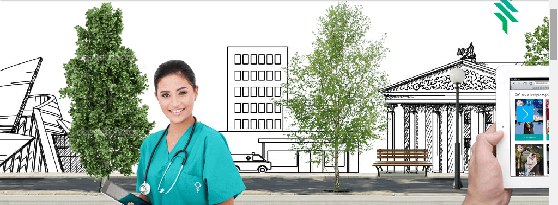

Slide 19
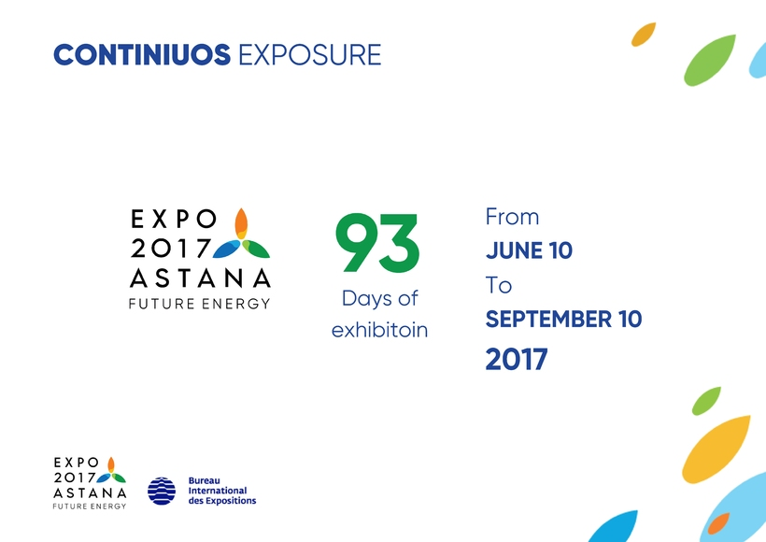

Slide 22
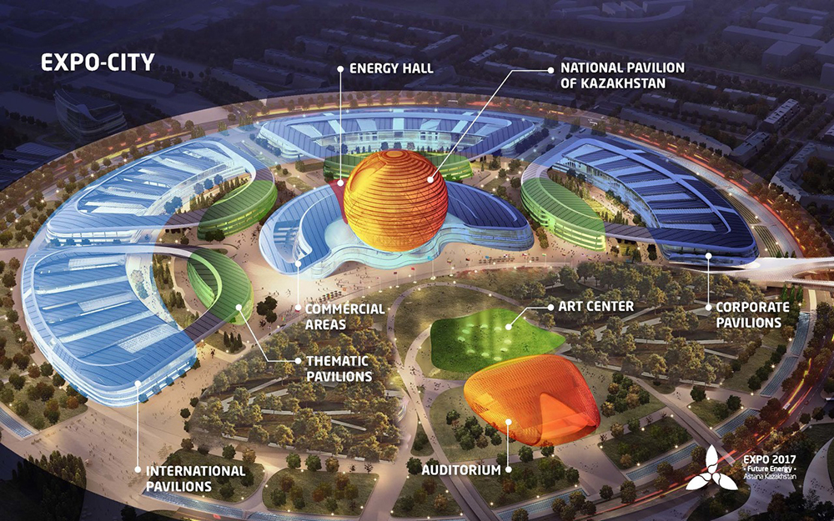

Slide 23
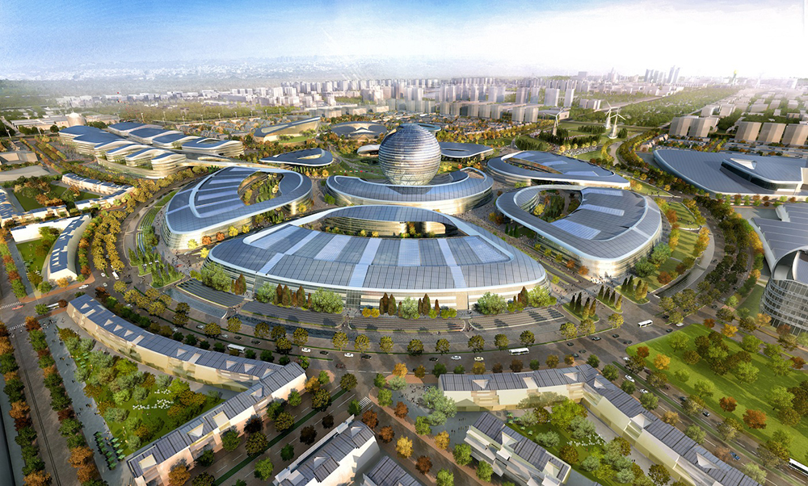
1 HUF = 1,07 KZT
expo2017astana.com

Slide 24
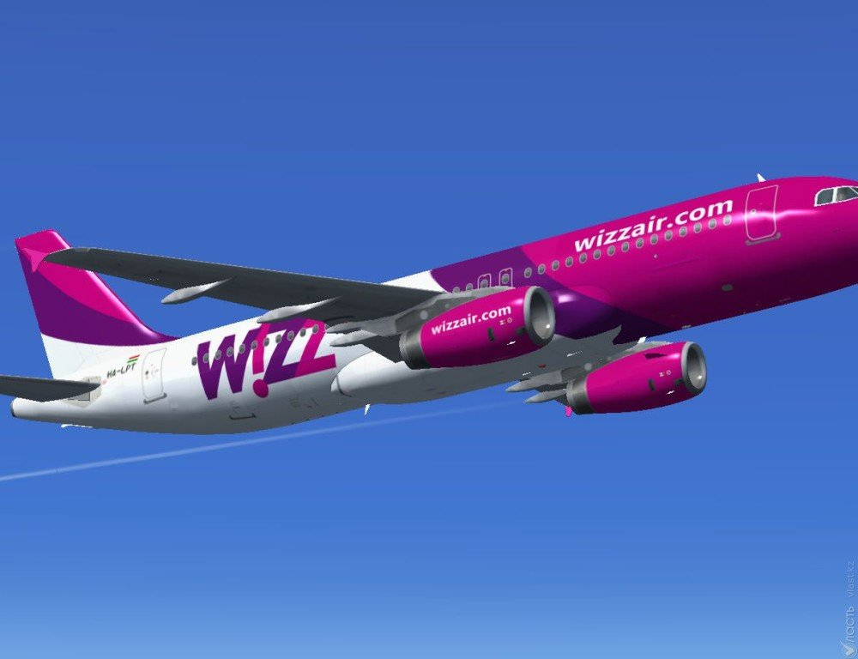
Astana - Budapest
5 hours
twice a week
starts on June 8th

Slide 25
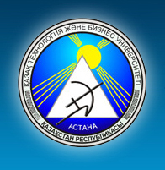
Thank you very much for you kind attention!
www.kazutb.kz
expo2017astana.com

